Slide 1

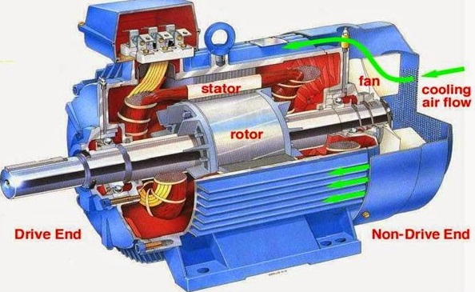
7.3 Advantages of Induction Motors
Notes:
let’s look at some of the key reasons why induction motors are so widely used in industry.

Slide 2
7.3 Advantages of Induction Motors
1. Simple and Robust Construction:
No brushes, commutators, or slip rings (in squirrel cage type), making them mechanically simple and very durable.
Notes:
First, they have a simple and robust construction. Especially in the squirrel cage type, there are no brushes or commutators, which means fewer parts to break or wear out. The rotor is just a set of shorted bars embedded in a laminated iron core—this simplicity makes them extremely reliable and tough in harsh environments.

Slide 3
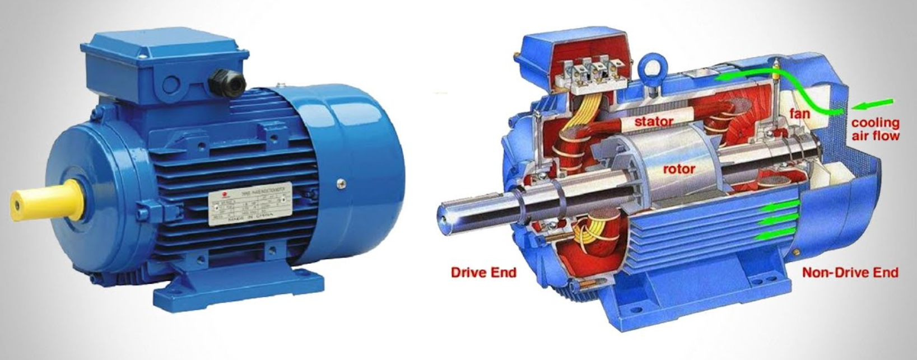
7.3 Advantages of Induction Motors
2. Low Maintenance:
Fewer moving parts mean less wear and tear, especially compared to DC motors that require regular brush maintenance.
Notes:
Second, they require very low maintenance. Because they’re brushless, there’s no need to replace brushes or clean commutators, like you would in DC motors. This reduces downtime and lowers operational costs over time.

Slide 4
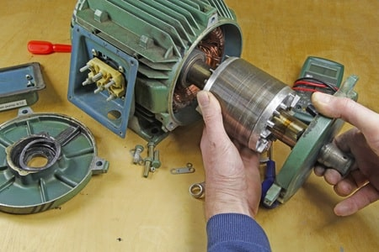
7.3 Advantages of Induction Motors
3. Cost-Effective:
Generally cheaper to manufacture, install, and maintain than DC or synchronous motors.
Notes:
Third, they’re cost-effective. From manufacturing to installation and long-term maintenance, induction motors are generally cheaper than both DC and synchronous motors—making them a go-to solution for many applications.

Slide 5
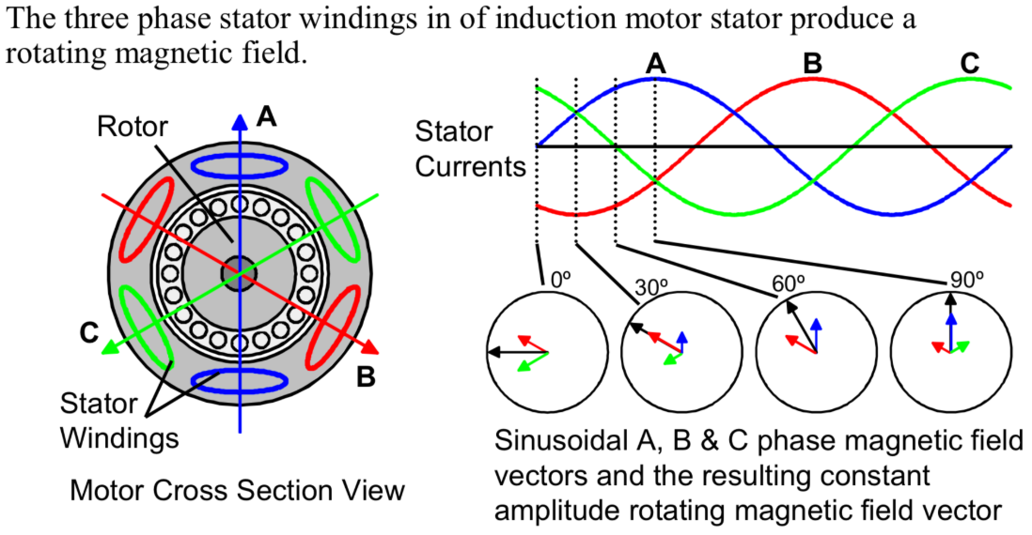
7.3 Advantages of Induction Motors
4. Self-Starting (3-phase):
Three-phase induction motors are inherently self-starting, unlike synchronous motors that require special starting methods.
Notes:
Fourth, three-phase induction motors are self-starting. Here’s how: when a three-phase AC supply is given to the stator, it creates a rotating magnetic field. This field induces a current in the rotor, which then interacts with the magnetic field to produce torque—all automatically, without the need for any external starter or controller.

Slide 6
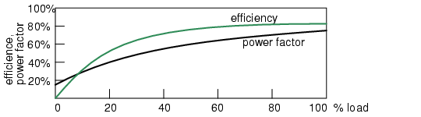
7.3 Advantages of Induction Motors
5. High Efficiency at Full Load:
Operates efficiently when running near rated load, making them suitable for continuous-duty applications.
Notes:
Fifth, they are highly efficient at full load. When running close to their rated capacity, induction motors operate with very little energy loss, making them ideal for machines that run continuously, like pumps and fans.

Slide 7
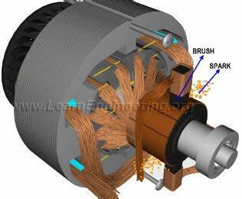
7.3 Advantages of Induction Motors
6. No Sparks (Brushless Design):
Particularly in squirrel cage motors, there's no sparking—making them suitable for hazardous environments.
DC Motor (Brushed)
Notes:
Sixth, their brushless design means there are no sparks during operation. This makes them a safer option in flammable or hazardous environments, like chemical plants or fuel-handling areas.

Slide 8
7.3 Advantages of Induction Motors
1. Poor Speed Control: 2. Low Starting Torque (in squirrel cage motors): 3. High Starting Current: 4. Poor Power Factor at Light Loads: 5. Lower Efficiency at Light Loads:
Notes:
In summary, these are just some of the main advantages. Others include wide availability, reliable performance under varying load, and the ability to withstand overload conditions without damage. Their combination of ruggedness, safety, and cost makes them one of the most commonly used motors in the world."

